Slide 1
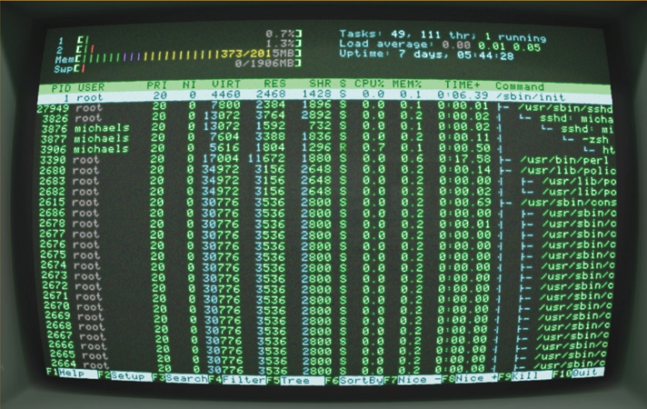
IT Essentials (CompTIA A+) Ch. 16
Working with Command Line
Interface (CLI)

Slide 2
Overview
In this chapter, you will learn how to:
Explain the operation of the CLI
Describe fundamental commands
Explain file manipulation
Describe additional useful Windows commands
Describe additional helpful Mac OS X and Linux commands

Slide 3
Introduction
Command-Line Interface (CLI)
Quick, powerful, and flexible tool
Necessary knowledge for all techs
Using the CLI
Usually faster than using a graphical user interface (GUI)
Natural choice for jobs where you don’t want or need a full-blown GUI for an OS
Text commands – very little bandwidth needed when sent across a network to another system

Slide 4
Deciphering the CLI
How does a CLI work?
Specific set of characters called a prompt indicates the computer is ready to do something. Example:
>: Want to play a game?
>: _
The user types in a command and presses ENTER.
The command is executed.
A new prompt is displayed—ready for the next command.
The command is executed just as it is when you double-click an icon in a Windows GUI.

Slide 5
Shells
Command-line interpreter known as the shell.
Default Windows shell is cmd.exe.
In Mac OS X and most Linux distributions, the default shell is called bash.
Every operating system can interface with different types of shells.
Alternative shells include:
PowerShell for Windows
Z shell (zsh), Korn shell (ksh), and C shell (csh) for Mac OS X and Linux

Slide 6
Accessing the CLI in Windows
Access the command line by starting the shell program cmd.exe.
Use the Start menu in Windows Vista/7.
Type cmd and press Enter
Use the Start screen’s search bar in Windows 8/8.1/10.
Start typing cmd and the Search charm will appear with the full command. Press Enter.
To close, click the Close box or type exit and press Enter.

Slide 7
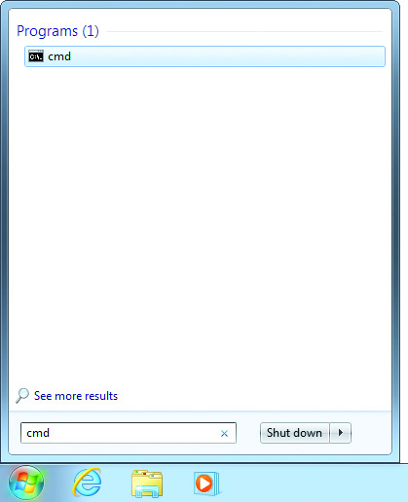
Accessing the CLI in Windows
Figure 16.1 Starting the command prompt in Windows 7

Slide 8
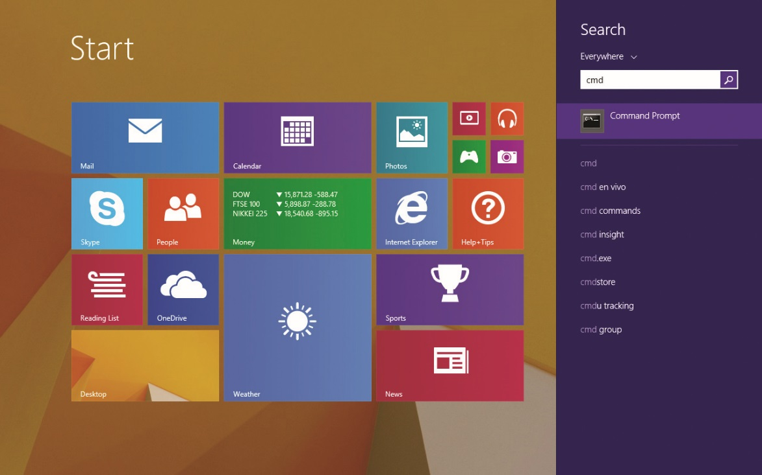
Accessing the CLI in Windows
Figure16.2 Starting the command prompt in Windows 8.1

Slide 9
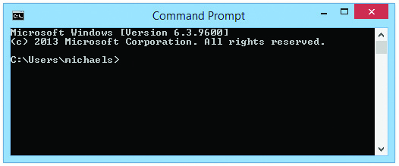
Accessing the CLI in Windows
Figure16.3 The Windows 8.1 CLI

Slide 10
Accessing the CLI in Windows
If you attempt to enter a command at the command prompt that requires administrative privileges:
You will receive a UAC dialog box.
An alternate method is to:
Right-click a command-prompt shortcut and select Run as administrator.
Enter credentials.
Notes:
You can create a shortcut to a Windows command prompt with elevated privileges by right-clicking on the desktop and selecting New | Shortcut. For the location of the item, type cmd and click Next. Type cmd to name the shortcut, and click Finish. The shortcut appears on the Desktop. Next, right-click the shortcut and select the Advanced button. In the Advanced Properties dialog box, check the Run as administrator box and click OK. You have now created a Windows command-prompt shortcut that will always run with administrative privileges.

Slide 11
Accessing CLI in Mac OS X and Linux
Command line functions are nearly identical in Mac OS X and Linux.
Both are based on UNIX.
Terminal emulator in Mac OS X is called the Terminal.
Linux uses names such as console, gnome-terminal, and Terminal.

Slide 12
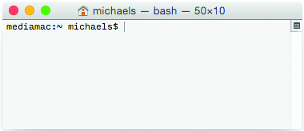
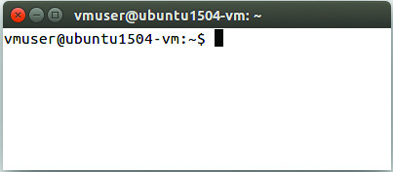
Accessing CLI in Mac OS X and Linux
Figure 16.4 Mac OS X Terminal
Figure 16.5 Linux Terminal
Notes:
Many Linux systems disable the root account for safety, rendering the su command inoperable. The sudo command enables users to do root things without having the root password.

Slide 13
Accessing CLI in Mac OS X and Linux
Ways to open Terminal in Mac OS X
Launch the Terminal app from the Utilities folder.
Activate Spotlight, type terminal, and press Enter.
Ways to open terminal emulator in Linux vary with Linux distribution (distro)
Using finder or search function on the desktop, type in terminal to start the program.
Super user or root privileges
The su and sudo commands give you the ability to run the command line with advanced privileges.

Slide 14
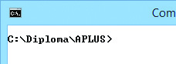
The Command Prompt
The command prompt is always focused on a specific folder, the working directory.
Commands operate on the files and folders in the folder on which the command line is focused.
First focus on the drive and folder where you want to work to make commands simpler.
Figure16.6 Command prompt indicating focus on the C:\Diploma\APLUS\ folder

Slide 15
Closing the Terminal
Type exit at the prompt.
Same method applies for Windows, Mac OS X and Linux.
The terminal window will disappear.

Slide 16
Filenames and File Formats
Each program or piece of data is stored as a file on the drive.
Names consist of the filename and the extension, separated by a dot.
In the early days of PCs, filename was limited to eight characters.
The extension tells the operating system which program uses the data.
Changing the extension does not affect file contents.
Notes:
Windows Filenames
Windows allows a lot of freedom in file naming, but it still has a handful of characters that you can’t use for file or folder names: / \ [ ] | ÷ + = ; , * ?
Filenames can be up to 255 characters in length.

Slide 17
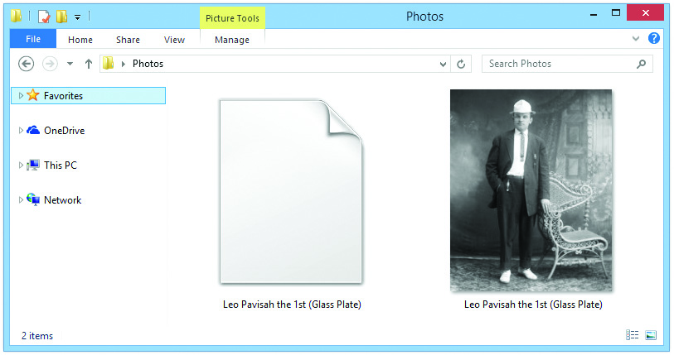
Filenames and File Formats
Figure 16.7 What kind of file is the one on the left?
Notes:
Figure 16.7 shows a folder with two identical image files. The one on the right shows a thumbnail because Windows recognizes this as a JPEG image; the one on the left shows a generic icon because I deleted the extension. Windows’ GUI doesn’t show file extensions by default.

Slide 18
Drives and Folders
Windows assigns drive letters to each hard drive partition.
Mac OS X and Linux don’t use drive letters.
The root drive is shown as a slash (/).
All other storage must go through mounting.
Most often to a single folder off the root drive
Root directory
The folder at the root of the directory tree
Subfolder
A folder inside another folder

Slide 19
Drives and Folders
C:\Test represents:
A folder named Test on the hard drive
C:\Test\System represents:
A subfolder named System in the Test directory
No two subfolders under the same folder can have the same name.
They may have the same name if they are in different folders.
Exact location of a file called its path.

Slide 20
Drives and Folders
Paths in Mac OS X and Linux use forward slash instead of backslash.
Forward slash is disallowed in filenames.
Linux is case sensitive.
Windows and Mac OS X are not case sensitive.
Mac OS X and Linux prompts show folder location shown differently than Windows.
A tilde (~) indicates your users folder.
The utility, pwd, shows the working directory.
Notes:
The CompTIA A+ objectives want you to know the pwd and passwd commands. You’ve seen the pwd command; later in this chapter we’ll cover passwd.

Slide 21
Fundamental Commands
Structure: syntax and switches
The proper way to write a command is called its syntax.
Switches modify the behavior of the command.
Type the name of the command and the desired or allowed switches, and then press ENTER to execute the command.
Multiple switches may be allowable.
To find the correct syntax and switches in Windows, type: [command name] /?
In Mac OS X or Linux, type man [command name].
Notes:
Combining Switches Extra text typed after a command to modify its operation, such as /w or /p after dir, is called a switch. Almost all switches can be used simultaneously to modify a command. For example, try typing ls –a –l –h in Mac OS X or Linux. With many commands, you can run multiple switches together. With the aforementioned ls, for example, ls –alh works just fine, with all three switches applied.

Slide 22
Viewing Directory Contents dir and ls
To show contents of the working directory:
Windows: dir command
Linux: ls command
The dir /p command will pause the results, which can be useful if the directory contents are long.
In Mac OS X and Linux, use ls | more.
Vertical line is known as the pipe command.
ls –l gives detailed information about the files.
Switch -l stands for long listing.
Notes:
Tech Tip: Do You Need Spaces? Some commands give you the same result whether you include spaces or not. Typing dir/p and dir /p, for example, provide the same output. Some commands, however, require spaces between the command and switches. In general, get into the habit of putting spaces between your command and switches and you won’t run into problems.

Slide 23
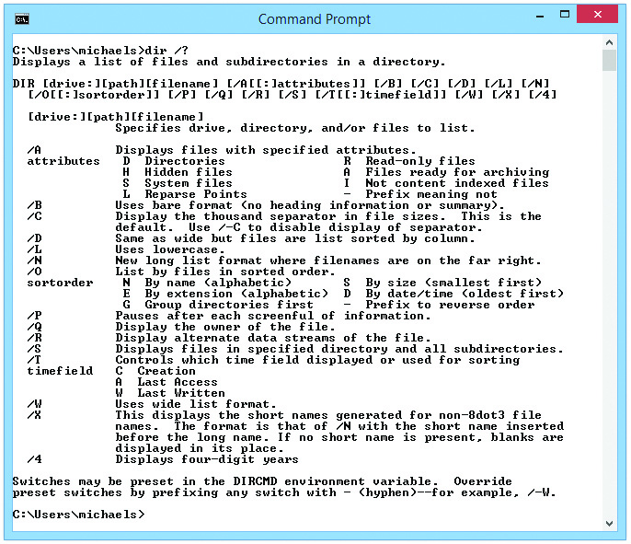
Switches for the dir command
Figure 16.8 Typing dir /? in Windows lists all possible switches for the dir command.

Slide 24
Changing Directory Focus The cd Command
cd works in every operating system
There are some differences between Windows, Mac OS X, and Linux.
The cd command brings focus to a different directory.
Type cd followed by name of the directory you want in focus.
Type cd \ and press ENTER to return to the root directory.
Use a forward slash in Mac OS X and Linux.

Slide 25
Changing Directory Focus: The cd Command
You can move one level at a time.
Type cd Obiwan
You can jump multiple directory levels in one step.
Type cd Obiwan\my\hope
To go up a single directory level:
Type cd..

Slide 26
Moving Between Drives in Windows
The cd command not used to move between drive letters.
Simply type the drive letter and a colon.
To return to the C: drive, type C:
Use the cd command to move the focus to any folder on a drive.

Slide 27
Moving Between Drives in Mac OS X and Linux
All media is mounted as a folder.
Locations vary between operating systems.
In Mac OS X, look in the /Volumes folder.
In Ubuntu Linux, look in the /mnt folder for drives and the /media/<user name> folder for removable media.
Explore using cd and ls commands to find location in other Linux distros.

Slide 28
Making Directories The md/mkdir Command
The md (or mkdir) command is used to create a directory.
Example: md files will make a new directory named files.
Use dir or ls to see the newly-made directory.
Remember that Linux is case sensitive.

Slide 29
Removing Directories The rd/rmdir Command
The rd (rmdir) command used for deleting empty directories and subdirectories
The rmdir works in Windows, Mac OSX, and Linux.
The rd command only works in Windows.
The rd command followed by the /s switch will remove populated folders and their contents.
Example: rd practice /s (practice is the directory name)
Be very sure before you run this command since there is no Recycle Bin!

Slide 30
Try This! Working with Directories
On a Windows system:
Create a new directory in your home directory.
Use dir to see your new directory.
Point the prompt to your new directory.
Make another new directory at this location.
Use dir to see this new subdirectory.
Change prompt focus to your home directory.
Delete the new directories using the /s switch.
Repeat the process on a Mac OS X or Linux system using appropriate commands.

Slide 31
Running a Program in Windows
To run a program:
Change the prompt focus to the directory where the program is stored.
Example: cd C:\Windows\System32
Type the name of the program with or without its extension and press ENTER.
Example: mmc.exe
Notes:
By and large, you can’t run Windows GUI-based applications within a command-line environment. Most will simply pop open in their own window, just as if you opened them from the Start menu. Try typing SYSEDIT at the command prompt within Windows and see what happens!

Slide 32
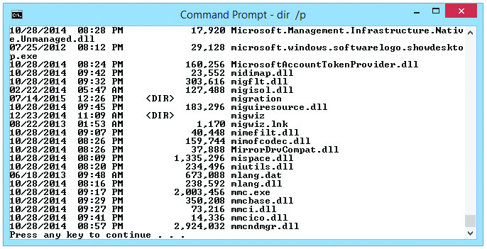
Running a Program in Windows
Figure 16.9 The mmc.exe program listed in the System32 folder
Notes:
To run the mmc.exe program, just type the filename, in this case mmc, and press ENTER (see Figure 16.9). Note that you do not have to type the .exe extension, although you can.

Slide 33
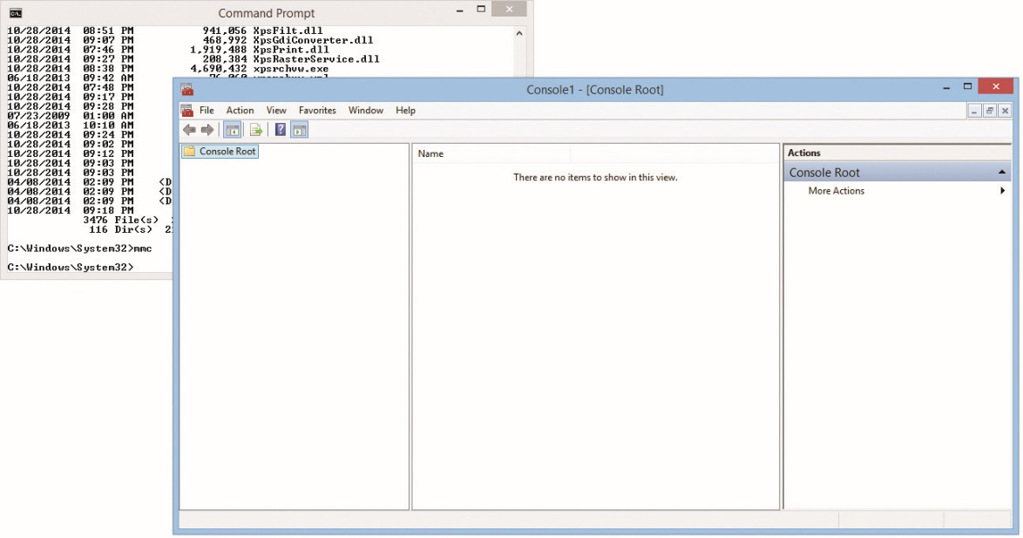
Running a Program in Windows
Figure 16.10 Running mmc in Windows

Slide 34
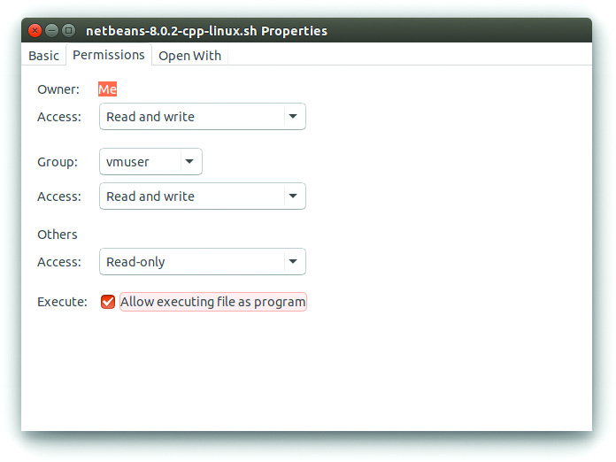
Running a Program in Mac OS X and Linux
Mac OS X and Linux do not rely on extensions.
Any file can be given the property of an executable file.
Figure 16.11 Showing file properties in Ubuntu

Slide 35
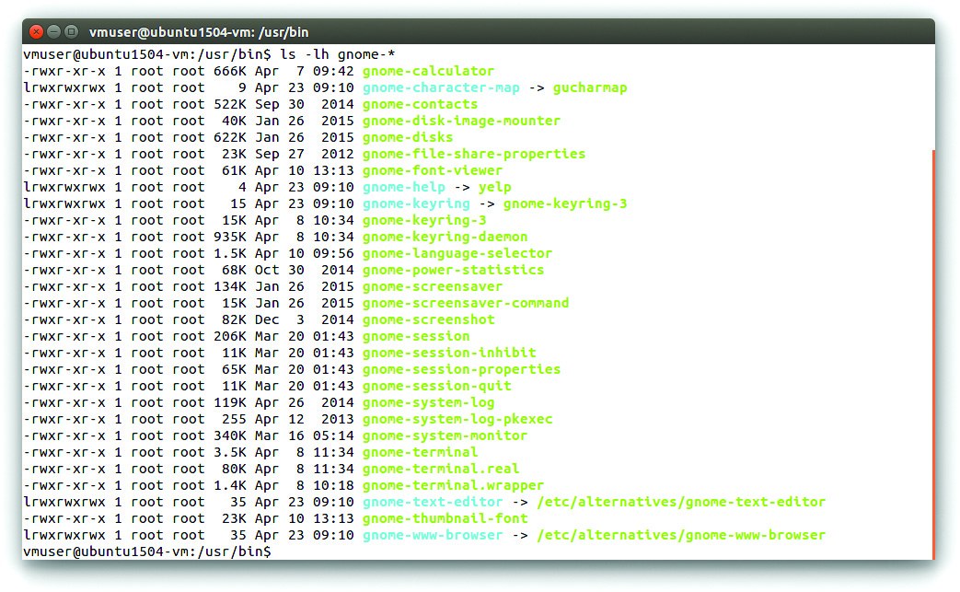
Running a Program in Mac OS X and Linux
Color coding indicates which files are executable files.
Figure 16.12 Color-coded files in Ubuntu

Slide 36
Running a Program in Mac OS X and Linux
There are two different types of executable files:
Built-in
Executables
In order to make Linux run a newly downloaded executable file, you need to add a period and a slash in front of the executable.
Example: ./runme

Slide 37
Working with Files
Dealing with basic file manipulation
Examples in chapter differ from your directories.
Follow the examples but use what’s on your drive.
Using wildcards to locate files
Wildcards are special characters that enable commands to act on more than one file at a time.
The * represents any number of characters.
The ? represents a single character.
For example, to find all files that end in .txt, type dir *.txt.

Slide 38
Deleting Files
The del (or erase) command is used to delete files in Windows.
rm command used in Mac OS X and Linux
Wildcards are allowed with del and rm commands to delete multiple files.
Remember, the command line has no Recycle Bin like the GUI.
Check twice and delete once.

Slide 39
Copying and Moving Files
Difference between copy and move
Whether or not the original is left behind
Windows commands
copy
move
Mac OS X and Linux commands
cp
mv

Slide 40
Five-Step copy/move Process
Point the command prompt to the directory containing the files to be copied or moved.
Type copy or move (Windows), or cp or mv (Linux or Mac OS X) and a space.
Type the name(s) of the file(s) to be copied or moved (with or without wildcards) and a space.
Type the path of the new location for the file(s).
Press Enter.

Slide 41
Pruning and Grafting Folder Trees
Pruning and grafting involve moving entire folders including all files and subfolders within the folder.
Faster with the command line than the GUI
Also gives you finer control
xcopy
Works like copy, but with extra switches that allow it to work with multiple directories
/s switch copies all subdirectories with files
/e switch copies empty subdirectories

Slide 42
Pruning and Grafting Folder Trees
robocopy (Robust File Copy)
Syntax: robocopy [source] [destination] [options]
Allows copying files or folders across a network
Fully replicates the directory structure on the destination system
Deletes anything not part of the copy
Can copy from the source and make the destination mirror it by using /mir switch
Can copy encrypted files
Attain full syntax by typing robocopy /?

Slide 43
cp and mv (again!)
Same cp and mv commands used for files in Linux can be used to copy folders and their contents.
A special switch is not needed to move or copy folders.

Slide 44
Assorted Windows Commands
chkdsk (/f /r)
Runs the command-line version of error-checking
Can use with switches
/f switch attempts to fix file system errors
/r switch attempts to locate and repair bad sectors
Needs access to a drive to run successfully
format
Enables formatting volumes from the command line
Can use format x: /q to wipe a drive effectively

Slide 45
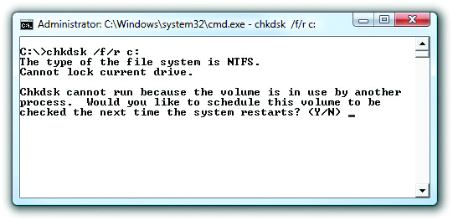
Assorted Windows Commands
Figure 16.13 The chkdsk /f /r utility and switches on a locked drive
Notes:
If you run chkdsk /f /r and chkdsk does not consider your drive unlocked, you will receive a “cannot lock current drive” message, meaning that another process has the drive locked and is preventing chkdsk from locking the drive itself. After this, chkdsk presents you with the option to run it the next time the system restarts (see Figure 16.13).

Slide 46
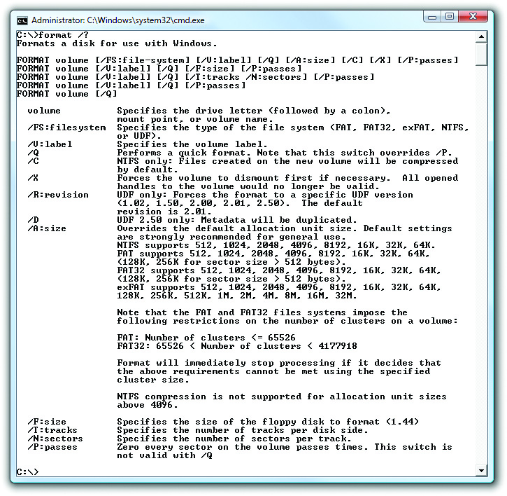
Assorted Windows Commands
Figure 16.14 Using format /? at the command prompt
Notes:
The very best way to familiarize yourself with the format command and its available switches is simply to enter format /? from the command prompt. Your results should be similar to those displayed in Figure 16.14.

Slide 47
Assorted Windows Commands
hostname
Used to display the name of your computer, also known as the hostname
gpupdate
Used to force a workstation to update to new group policies
gpresult
Provides a quick overview of all security policies applied to a single user or computer

Slide 48
Assorted Windows Commands
sfc (System File Checker)
Scans, detects, and restores important Windows system files, folders, and paths
Enter sfc /scannow from a command prompt
shutdown
Used to shut down or reboot a local or remote machine
/r switch tells it to reboot

Slide 49
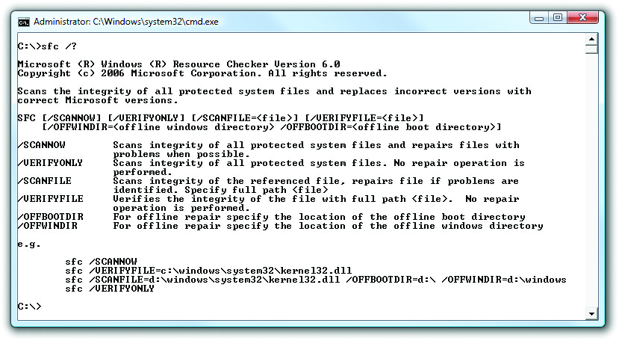
Assorted Windows Commands
Figure 16.15 Checking sfc options with sfc /? at a command prompt

Slide 50
Using Special Keys in Windows
F1 function key brings back the previous command one letter at a time.
F3 function key brings back the entire command at once.
Arrow keys allow scrolling and editing.
You can use the arrow keys (up and down) to scroll through commands.
Arrow keys (left to right) enable you to edit commands.
Notes:
You can use the up and down arrow keys on the keyboard to scroll through previously typed commands.

Slide 51
The compact and cipher Commands
The compact command displays or alters the compression of files on NTFS partitions.
The cipher command displays or alters the encryption of folders and files on NTFS partitions.
Typed without added parameters, the commands display the current compression and encryption states.

Slide 52
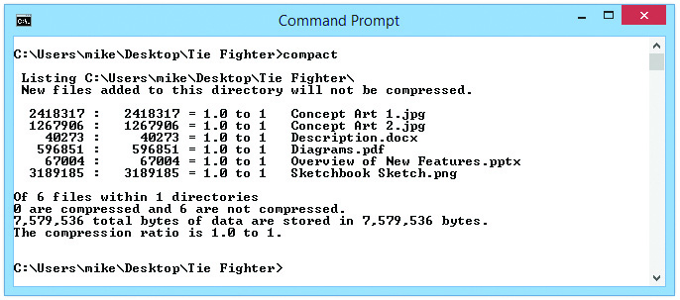
The compact and cipher Commands
Figure 16.16 The compact command with no switches

Slide 53
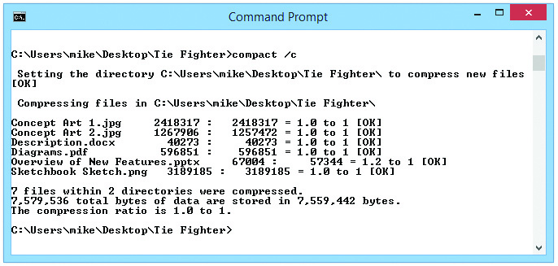
The compact and cipher Commands
Figure 16.17 Typing compact /c compresses the contents of the directory.
Notes:
If you enter the COMPACT command with the /c switch, it compresses all of the files in the directory, as shown in Figure 16.17.

Slide 54
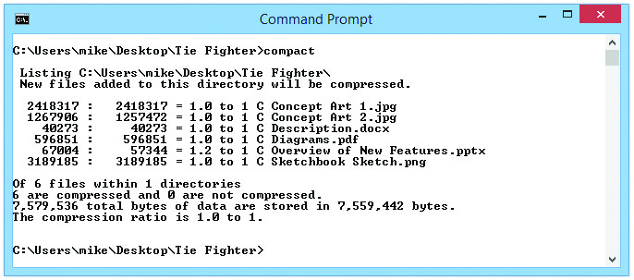
The compact and cipher Commands
Figure 16.18 The contents have been compressed.
Notes:
Typing compact again shows you the directory listing, and now there’s a C next to each filename, indicating that the file is compressed (see Figure 16.18).

Slide 55
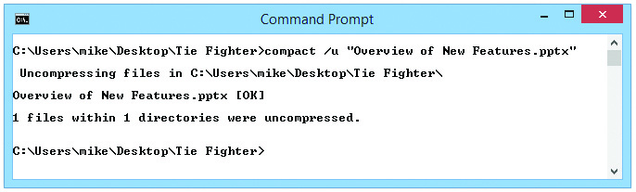
The compact and cipher Commands
Figure 16.19 Typing compact /u “Overview of New Features.pptx" decompresses only that file.
Notes:
To decompress a file, you must specify the decompression operation, using the /u switch and the name of the file you want decompressed, as shown in Figure 16.19.

Slide 56
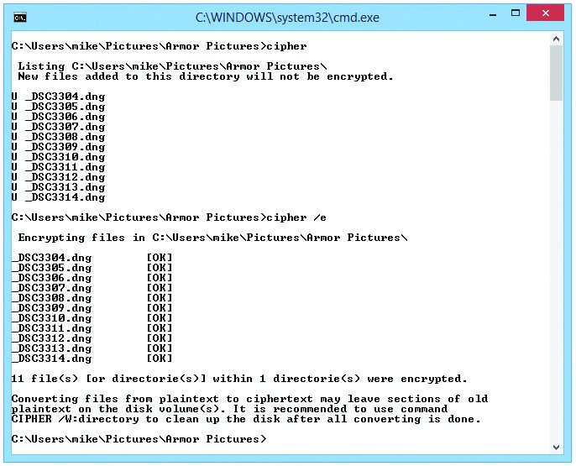
The compact and cipher Commands
Figure 16.20 The cipher command showing the unencrypted files followed by results of running cipher /e
Notes:
Figure 16.20 shows two steps in the process. Like the COMPACT command, the CIPHER command simply displays the current state of affairs when entered with no switches. In this case, it displays the encryption state of the files in the E:\Users\mike\Pictures\Armor Pictures directory. Notice the letter U to the left of the filenames, which tells you they are unencrypted. The second command you can see on the screen in Figure 16.20 is this: E:\Users\mike\Pictures>cipher /e.

Slide 57
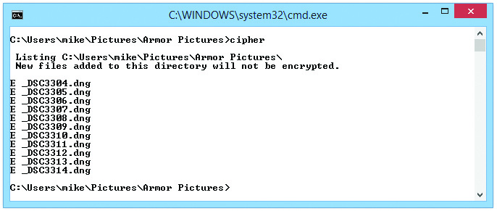
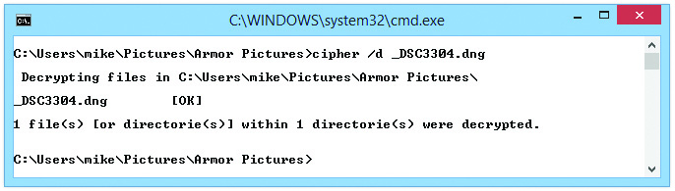
The compact and cipher Commands
Figure 16.21 The cipher command confirms that the files were encrypted.
Figure 16.22 Typing cipher /d _DSC3304.dng decrypts only that file.
Notes:
To confirm the results of the cipher operation, enter the cipher command again, as shown in Figure 16.21. Note that the U to the left of each filename has been replaced with an E, indicating an encrypted file.
To decrypt a single file, simply add the filename of the file you want to decrypt after the command and the relevant switches. Figure 16.22 shows the cipher command being used to decipher _DSC3304.dng, a single file.

Slide 58
PowerShell
PowerShell is a more powerful replacement for the traditional Windows CLI.
Uses powerful tools called cmdlets
Syntax slightly more complex than regular command-line use.
Type powershell in the search bar and press ENTER.

Slide 59
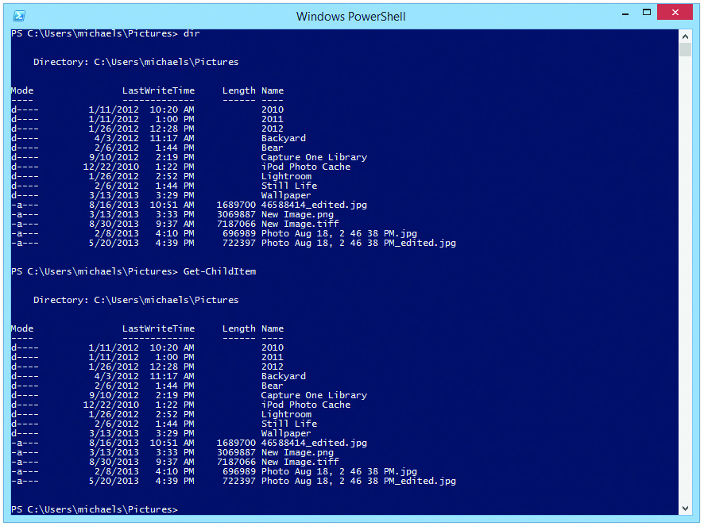
PowerShell
Figure 16.23 Simple commands in PowerShell
Notes:
Figure 16.23 shows two commands, dir and get-childitem, that do the same thing by default—show the contents of a directory.

Slide 60
Assorted Mac OS X and Linux Commands
ifconfig
Used to change network connection settings
iwconfig
Used to change wireless network settings
ps
Lists the processes running on the system
grep
Enables you to search through text file or command output to find specific information or filter out unneeded information

Slide 61
Assorted Mac OS X and Linux Commands
apt-get
Command line tool for advanced packaging tool (APT) used on Linux Ubuntu and Mint
Used for fetching and installing single applications
Can also manage all software on the system
Need to know the name of the package you want to install
vi
Default text editor
Editor is always in either insert mode or command mode

Slide 62
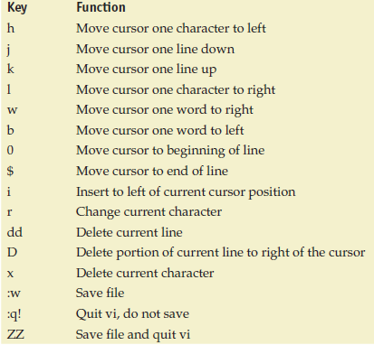
Assorted Mac OS X and Linux Commands
Some of the vi command mode keys

Slide 63
Assorted Mac OS X and Linux Commands
dd
Primarily used to create exact, bit-by-bit image of any form of block storage
Example uses
Copying a hard drive
Backing up a removable flash drive
Wiping a disk

Slide 64
Assorted Mac OS X and Linux Commands
shutdown
Shutdown <options> <time>
Shutdown now
Shutdown –r now (will reboot)
passwd
Enables you to change your password
Can change any user’s password if logged in as root (super user)

Slide 65


Slide 66
Summary
Explain the operation of the CLI
Describe fundamental commands
Explain file manipulation
Describe additional useful Windows commands
Describe additional helpful Mac OS X and Linux commands

Slide 67


